Slide 1
Changing SVGs Dynamically

Slide 2
SVG DOM
SVGs have their own DOM (Document Object Model), which is simply a programming interface that allows the SVG, and elements contained within the SVG, to be controlled via code. Creation, removal, animation, changing shape and color - all are possible using JavaScript and CSS.

Slide 3

setAttribute
<svg width="500" height="500" viewbox="0 0 500 500">
<circle id="my_circle" cx="250" cy="250" r="150" stroke="black" stroke-opacity=".2" stroke-width="3" fill="purple" />
</svg>
All attributes of an svg element - positioning, orientation, presentation, etc. - can be changed with javascript.
For example, let’s say we have a simple SVG that contains a purple circle.

Slide 4
setAttribute
<svg width="500" height="500" viewbox="0 0 500 500">
<circle id="my_circle" cx="250" cy="250" r="150" stroke="black" stroke-opacity=".2" stroke-width="3"
fill="purple" />
</svg>
We can change the color of the circle from purple to green by changing the value of the fill attribute.

Slide 5
setAttribute
<svg width="500" height="500" viewbox="0 0 500 500">
<circle id="my_circle" cx="250" cy="250" r="150" stroke="black" stroke-opacity=".2" stroke-width="3"
fill="purple" />
</svg>
<script>
let my_circle = document.getElementById("my_circle");
</script>
To do so, we’ll first need to create a reference to the circle element.

Slide 6

setAttribute
<script>
let my_circle = document.getElementById("my_circle");
my_circle.setAttribute('fill', 'blue')
</script>
You can then change the elements attribute using the setAttribute method.
The setAttribute method has two parameters. The first is the name of the attribute you wish to change, and the second is the new value you wish to assign to the attribute.
element.setAttribute(name, value)

Slide 7
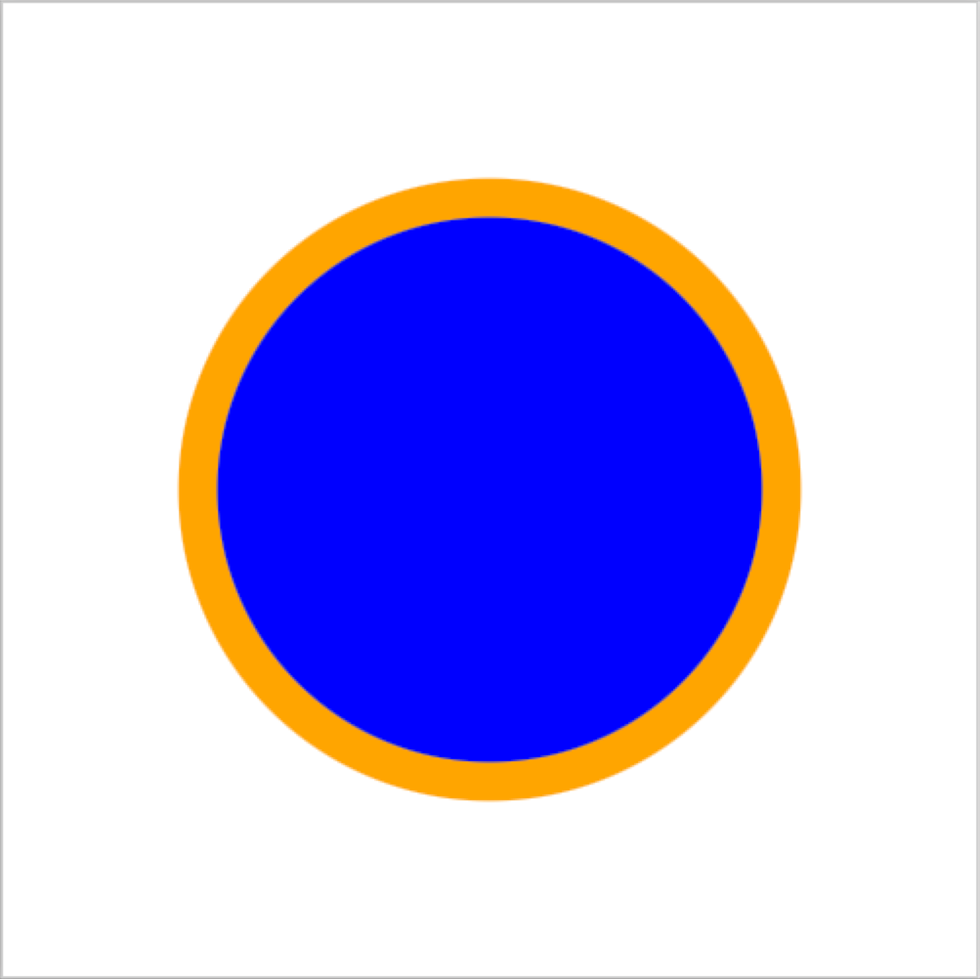
setAttribute
<script>
let my_circle = document.getElementById("my_circle");
my_circle.setAttribute('fill', 'blue');
my_circle.setAttribute('stroke', 'orange');
my_circle.setAttribute('stroke-width', '20');
my_circle.setAttribute('stroke-opacity', '1');
</script>
Now let’s change the stroke color, width, and opacity:

Slide 8

setAttribute - text
<text id="my-text" text-anchor="middle" x="250" y="250" fill="black" font-size="18" font-weight="100">hello world</text>
.
.
.
const myText = document.getElementById("my-text");
myText.setAttribute("fill", "red");
myText.setAttribute("font-weight", 900);
myText.setAttribute("font-size", 30);
The text element is no different from any of the other shape elements. Here we change a text elements fill from black to red, the font-weight to 900, and the font-size to 30.

Slide 9
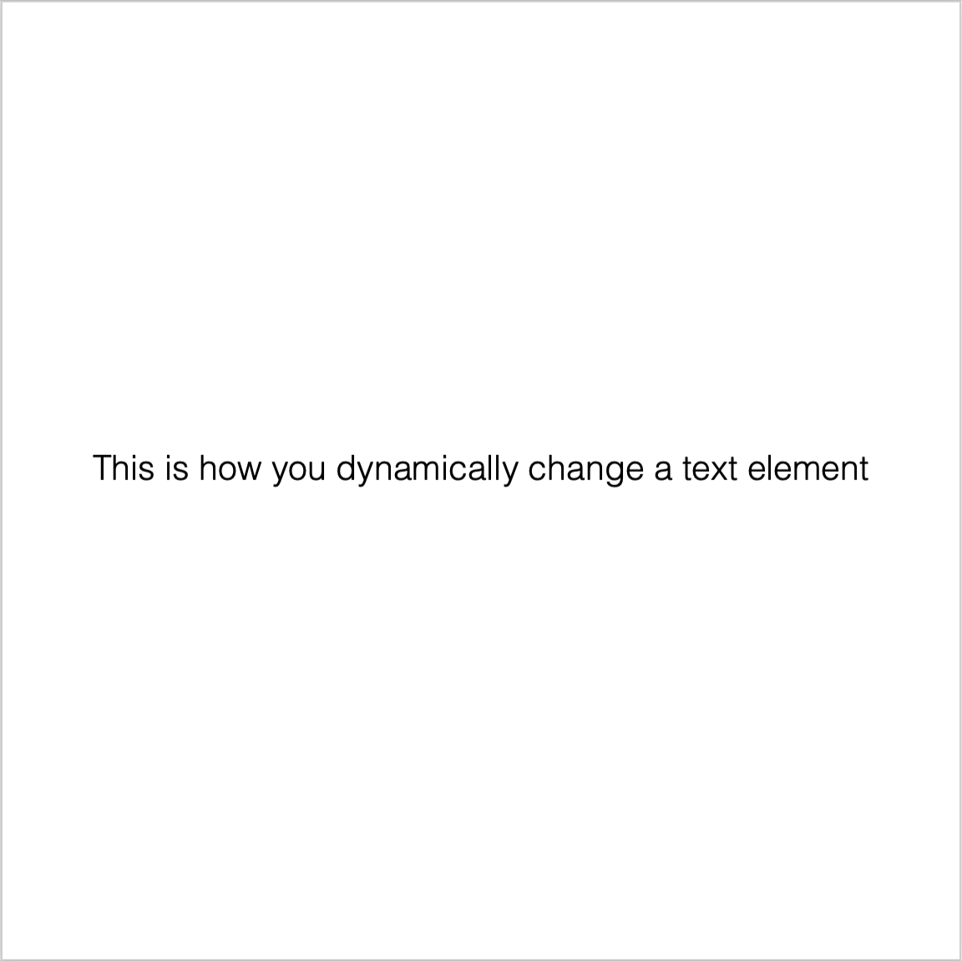
text - firstChild.textContent
<text id="my-text" text-anchor="middle" x="250" y="250" font-size="18" font-weight="100">hello world</text>
.
.
.
const myText = document.getElementById("my-text");
myText.firstChild.textContent = "This is how you dynamically change a text element";
Changing the text contained in a text element is quite simple, and virtually identical to how you would do so with ordinary html text. Simply create a reference to the text element and use firstChild.textContent to set the content. In this example, I've replaced the original "hello world" text with a different text string.

Slide 10
setAttribute
Interactive example:
28_change_attributes.html

Slide 11
getAttribute
<svg width="500" height="500" viewbox="0 0 500 500">
<circle id="my_circle" cx="250" cy="250" r="150" stroke="black" stroke-opacity=".2" stroke-width="3"
fill="purple" />
</svg>
<script>
let my_circle = document.getElementById("my_circle");
let fill = my_circle.getAttribute("fill"); // purple
</script>
What if you wanted to retrieve the value of an element attribute? You would use the getAttribute method.
element.getAttribute("<name>")

Slide 12
getAttribute
The getAttribute method is particularly useful when animating elements, as we’ll see later in the course

Slide 13
createElementNS
<script>
const namespace = "http://www.w3.org/2000/svg"
let my_circle = document.createElementNS(namespace, "circle");
</script>
You can create an svg element using the createElementNS method.
document.createElementNS(<namespace>, <element name>)

Slide 14
createElementNS
<script>
const namespace = "http://www.w3.org/2000/svg"
let my_circle = document.createElementNS(namespace, "circle");
my_circle.setAttribute('cx', 250);
my_circle.setAttribute('cy', 250);
my_circle.setAttribute('r', 150);
my_circle.setAttribute('fill', purple);
my_circle.setAttribute('stroke', none);
</script>
After creating the element, add all the attributes with the setAttribute method

Slide 15
createElementNS
<script>
const namespace = "http://www.w3.org/2000/svg"
let my_circle = document.createElementNS(namespace, "circle");
my_circle.setAttribute('cx', 250);
my_circle.setAttribute('cy', 250);
my_circle.setAttribute('r', 150);
my_circle.setAttribute('fill', purple);
my_circle.setAttribute('stroke', none);
const my_svg = document.querySelector("svg")
my_svg.appendChild(my_circle)
</script>
Finally, add the element to the svg:

Slide 16
createElementNS
You may be familiar with the similarly named createElement method, used to create HTML elements. Why can’t we just use that? Because the SVG “namespace” isn’t the same as the HTML namespace. If you try to create an svg “circle” element with createElement, the browser won’t know what to do with it because it thinks it’s just an unknown html element. By passing the SVG namespace, you’re telling the browser that you want to create an SVG element, and NOT an HTML element.

Slide 17

generating elements
Creating simple shapes and paths is easy enough, but what if you want to create something a bit more complex? One way to do so is to replicate objects defined in the defs section.
For example suppose you created a leaf graphic in Figma, and you wanted to create multiple copies of it.

Slide 18
generating elements
<svg width="100" height="130" viewBox="0 0 100 130" fill="none" xmlns="http://www.w3.org/2000/svg">
<g id="leaf">
<path id="surface"
d="M51.4655 0C63.6939 34.1153 106.134 64.906 99.2498 105.295C93.1444 141.114 23.6633 135.225 5.41848 105.295C-12.8264 75.3643 18.1546 42.0639 51.4655 0Z"
fill="#8CE16F" />
<!-- more stuff here -->
</g>
</svg>
Here’s the SVG code. Let’s take the code and paste it into the <defs> section of an inline SVG

Slide 19

generating elements
<defs>
<g id="leaf">
<!--leaf stuff here-->
</g>
</defs>
<script>
const svg = document.querySelector("svg");
const namespace = "http://www.w3.org/2000/svg"
let my_leaf = document.createElementNS(namespace, "use");
my_leaf.setAttribute('href', '#leaf');
svg.appendChild(my_leaf);
</script>
To place the leaf dynamically, we can create the <use> element and pass in the leaf id as the href value

Slide 20

generating elements
<defs>
<g id="leaf">...
// more defs stuff
.
<script>
const svg = document.querySelector("svg");
const namespace = "http://www.w3.org/2000/svg"
let my_leaf = document.createElementNS(namespace, "use");
my_leaf.setAttribute('href', '#leaf');
my_leaf.setAttribute("x", 200);
my_leaf.setAttribute("y", 175);
svg.appendChild(my_leaf);
</script>
We can change the leaf’s position by adding x and y values.

Slide 21

generating elements
<script>
const svg = document.querySelector("svg");
const namespace = "http://www.w3.org/2000/svg"
for (let i = 0; i < 30; i++) {
let my_leaf = document.createElementNS(namespace, "use");
my_leaf.setAttribute('href', '#leaf');
// let’s create random x and y values
const xpos = Math.random() * 500; // value between 0-500
const ypos = Math.random() * 500; // value between 0-500
my_leaf.setAttribute("x", xpos);
my_leaf.setAttribute("y", ypos);
svg.appendChild(my_leaf);
}
</script>
Let’s use a loop to create a bunch of leaves and position them randomly

Slide 22

generating elements
<script>
const svg = document.querySelector("svg");
const namespace = "http://www.w3.org/2000/svg"
for (let i = 0; i < 30; i++) {
let my_leaf = document.createElementNS(namespace, "use");
my_leaf.setAttribute('href', '#leaf');
// let’s create random x and y values
const xpos = Math.random() * 500; // value between 0-500
const ypos = Math.random() * 500; // value between 0-500
my_leaf.setAttribute("x", xpos);
my_leaf.setAttribute("y", ypos);
const angle = Math.random() * 180;
const scale = .75 + Math.random() * .25;
my_leaf.setAttribute("transform", `scale(${scale}) rotate(${angle}, ${xpos}, ${ypos})`);
svg.appendChild(my_leaf);
}
</script>
Now we’ll rotate and scale the leaves to make for a more realistic scatter

Slide 23
generating elements
for (let i = 0; i < 30; i++) {
let my_leaf = document.createElementNS(namespace, "use");
my_leaf.setAttribute('href', '#leaf');
.
.
// <all the stuff we just did>
.
my_leaf.setAttribute('fill', 'orange');
}
Now let’s try changing the fill color for the leaves. The fill color remains the same after we use setAttribute to change the fill to orange. Why?

Slide 24
generating elements
<svg>
<g id="leaf">
<path id="surface" d="M51.4655 0C63.6939 34.1153 106.134 64.906 99.2498 105.295C93.1444 141.114 23.6633 135.225 5.41848 105.295C-12.8264 75.3643 18.1546 42.0639 51.4655 0Z" fill="#8CE16F"/>
<!--more stuff here-->
</g>
</svg>
The “surface” path (which defines the leaf surface) already has a fill attribute defined. Remember from our lesson on groups - presentation attributes defined on child elements override those set on the group.

Slide 25
generating elements
<svg>
<g id="leaf">
<path id="surface" d="M51.4655 0C63.6939 34.1153 106.134 64.906 99.2498 105.295C93.1444 141.114 23.6633 135.225 5.41848 105.295C-12.8264 75.3643 18.1546 42.0639 51.4655 0Z" fill="#8CE16F"/>
<!--more stuff here-->
</g>
</svg>
If we want to set the fill dynamically on the group level, we need to delete the fill defined on the surface path

Slide 26

generating elements
for (let i = 0; i < 30; i++) {
let my_leaf = document.createElementNS(namespace, "use");
my_leaf.setAttribute('href', '#leaf');
.
.
// <all the stuff we just did>
.
my_leaf.setAttribute('fill', 'orange');
}
Now we can set the fill color dynamically

Slide 27

generating elements
const getColor = () => {
const h = Math.round(Math.random() * 360);
const s = 50 + Math.round(Math.random() * 50);
const l = 40 + Math.round(Math.random() * 50);
return `hsl(${h}, ${s}%, ${l}%)`
}
for (let i = 0; i < 30; i++) {
let my_leaf = document.createElementNS(namespace, "use");
my_leaf.setAttribute('href', '#leaf');
// <code and stuff>
my_leaf.setAttribute('fill', getColor());
}
Just for fun, let’s set the leaves to random colors. I've created a getColor() function that returns an hsl color string we can use with setAttribute to set the fill color.

Slide 28
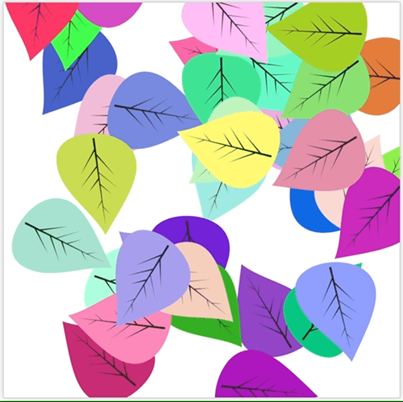
removing elements
for (let i = 0; i < 30; i++) {
let my_leaf = document.createElementNS(namespace, "use");
.
.
// <code and stuff>
my_leaf.addEventListener("click", () => {
my_leaf.remove();
})
}
Removing elements is even easier. Just use the DOM’s element.remove() method. Let’s add a click event handler to each leaf to do just that.

Slide 29

changing filter attributes
<defs>
<radialGradient id="sun-gradient" cx="50%" cy="50%">
<stop offset="0" stop-color="#FAEEB0"></stop>
<stop offset="100%" stop-color="#FB9700"></stop>
</radialGradient>
</defs>
Even filter attributes can be set dynamically. For example, here’s the filter for the image at right.

Slide 30

changing filter attributes
<defs>
<radialGradient id="sun-gradient" cx="50%" cy="50%">
<stop offset="0" stop-color="#FAEEB0"></stop>
<stop offset="100%" stop-color="#FB9700"></stop>
</radialGradient>
</defs>
.
.
<script>
const sun_gradient = document.querySelector('#sun-gradient');
sun_gradient.setAttribute("cx", "20%");
sun_gradient.setAttribute("cy", "20%");
We can change the gradient by updating it’s attributes. Let’s change the origin of the gradient from the center to the upper right.

Slide 31
changing filter attributes
<defs>
<radialGradient id="sun-gradient" cx="50%" cy="50%">
<stop id="first_stop" offset="0" stop-color="#FAEEB0" />
<stop id="second_stop" offset="100%" stop-color="#FB9700" />
</radialGradient>
</defs>
<script>
const sun_gradient = document.querySelector('#sun-gradient');
const first_stop = document.querySelector('#first_stop');
const second_stop = document.querySelector('#second_stop);
We can even change the gradient colors. In order to do that, we’ll need to add id attributes to the stop elements so that we can target them

Slide 32
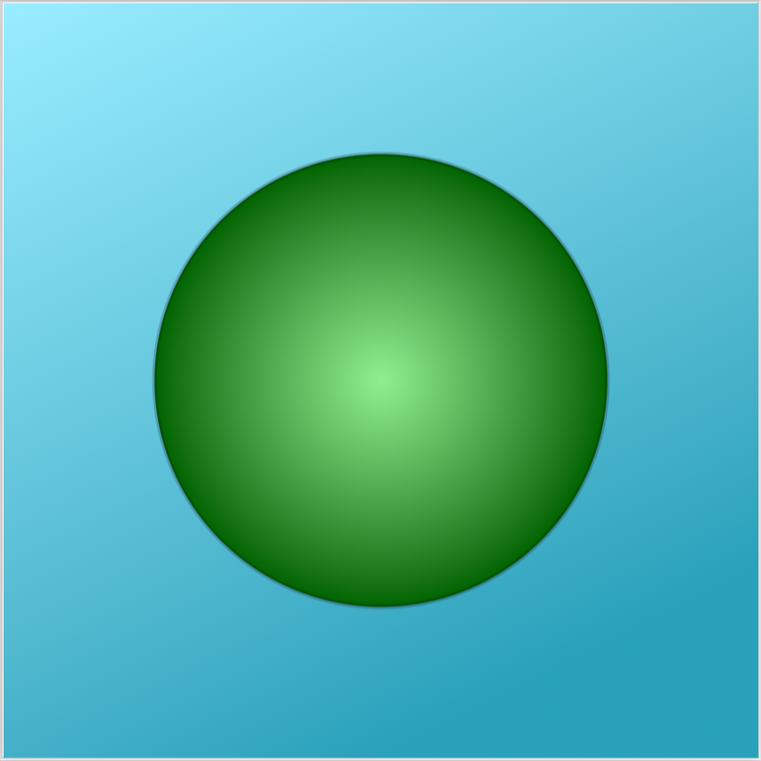
changing filter attributes
<defs>
<radialGradient id="sun-gradient" cx="50%" cy="50%">
<stop id="first_stop" offset="0" stop-color="#FAEEB0" />
<stop id="second_stop" offset="100%" stop-color="#FB9700" />
</radialGradient>
</defs>
<script>
const sun_gradient = document.querySelector('#sun-gradient');
const first_stop = sun_gradient.querySelector('#first_stop');
const second_stop = sun_gradient.querySelector('#second_stop);
first_stop.setAttribute("stop-color", "lightgreen");
second_stop.setAttribute("stop-color", "darkgreen");
</script>
Now let’s change the colors.

Slide 33
Dynamically generating colors. AND FILTER ATTRIBUTES
See 37c_Dynamic_Creation_using_defs.html. Also

